Slide 1
Enhancing Bank Robustness through Dynamic Control of Leverage (DCL) in Contingent Convertible Bonds (CoCos): A Case Study Analysis
Steinar Björnsson
Thesis of 30 ECTS credits submitted to the Department of Engineering at Reykjavík University in partial fulfillment of the requirements for the degree of Master of Science
Supervisor: Dr. Sverrir Ólafsson
Co-Supervisor: Dr. Maxime Elliott Tullio Segal
Examiner: Yngvi Harðarson
26. May 2025
Notes:
Hello and welcome
Title
Why i am interested (Bank robustness)
I want to begin by explaining what contingent convertible bonds, also called cocos are, [next]

Slide 2
Contingent Convertible Bonds (CoCos)
Bonds that are automatically converted into equity (or written down) during financial distress.
Aim is to avoid taxpayer-funded bailouts
Most conversion triggers are based on the CET1 ratio:
7% or higher (high trigger CoCos)
5.125% (low trigger CoCos)
Most CoCos allow the regulator to force a conversion
Notes:
Break down sentence
Higher trigger -> Better for robustness of the bank
Lower trigger -> Better for CoCo bondholders
CET1: Common equity tier 1 – meaasure of the ratio of high quality assets for the bank

Slide 3
Timeline
Pre 2008:
Flannery, Squam Lake Working Group lay out the general framework for Contingent Capital bonds
2008:
Great Financial Crisis
2009 - 2011:
Lloyds issues Enhanced Capital Notes
Basel III set conditions for inclusion as AT1 and Tier 1 capital
CET1 at 5.125% to be considered AT1 capital
Credit Suisse, issue high trigger CoCos
2013:
~$70 Billion issued since inception
2023:
CoCo/AT1 market grown to ~$275 Billion
March 19, 2023 (Credit Suisse crisis):
FINMA announces a complete write-down of Credit Suisse CoCo bonds
Contingent Convetible bonds (CoCos)
Sas
hh
r
(pre 2008 -> 2008 response (BIS, flannery, Lloyds & Credit Suisse issuances) -> (Change in trigger popularity) -> 2023 Credit Suisse collapse -> criticisms of CoCos
DCL bonds (Describe the triggers)
Case studies (Credit Suisse, Deutsche Bank, Lehman)
Minimum Leverage adjustments
Time gained as a design objective
Notes:
Before going further
Pre 2008
2008 GFC: In response to the 2008 crisis, contingent convertible (CoCo) are introduced as a mechanism to strengthen bank stability by automatically converting debt into equity during financial distress.
March 19, 2023: The Swiss Financial Market Supervisory Authority (FINMA) announces the complete write-down of Credit Suisse's Additional Tier 1 (AT1) bonds, amounting to approximately CHF 16 billion.
Going forward: Dynamic Control of Leverage (DCL) introduced to prevent sudden drawdowns by only drawing down interest payments during times of high leverage, therefore gradually adjusting the balance sheet.
My task is to analyse DCLs in real world scenarios.
FINMA announces a complete write-down of Credit Suisse CoCo bonds
Bondholders wiped out before shareholders
Uncertainty around regulatory discretion
Triggers based on book values (CET1)
as part of a rescue merger with UBS
The collapse of Credit Suisse in 2023 and the subsequent write-down of CHF 16 billion worth of Additional Tier 1 (AT1) CoCo bonds by the Swiss Financial Market Supervisory Authority (FINMA) sent shockwaves through financial markets.
Market reactions were immediate, with a sharp decline in AT1 bond prices globally and increased scrutiny of CoCo bonds and regulatory decision-making

Slide 4
Criticisms of traditional CoCo bonds
Bail-in only occurs at a point of non-viability (PONV)
Triggers generally based on accounting ratios (CET1)
Lack responsiveness and transparency
Researchers have propose to use market based triggers instead
ERN (equity recourse notes)
DCL (dynamic control of leverage)
Notes:
Market based triggers carry their own risk (manipulation)
ECN (equity recourse notes)

Slide 5

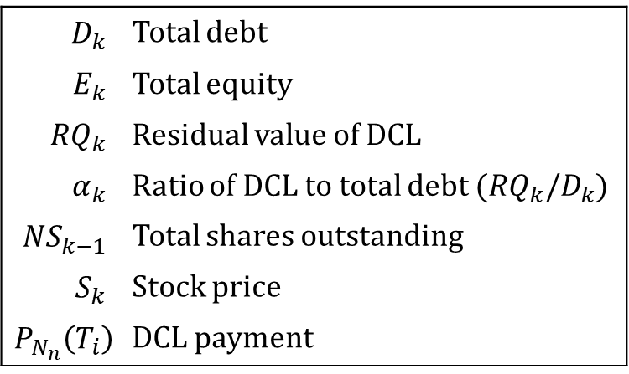
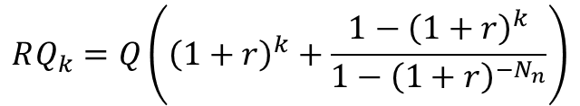

Dynamic Control of Leverage (DCL)
Dynamic control of leverage:
Variables:
$$D_{k}$$ | Total debt
$$E_{k}$$ | Total equity
$${RQ}_{k}$$ | Residual value of DCL
$$α_{k}$$ | Ratio of DCL to total debt (${RQ}_{k}/D_{k}$)
$${NS}_{k−1}$$ | Total shares outstanding
$$S_{k}$$ | Stock price
$$P_{N_{n}}\left(T_{i}\right)$$ | DCL payment
$$P_{N_{n}}\left(T_{i}\right)=\frac{rQ}{1−{\left(1+r\right)}^{−N_{n}}}$$
$$RQ_{k}=Q\left({\left(1+r\right)}^{k}+\frac{1−{\left(1+r\right)}^{k}}{1−{\left(1+r\right)}^{−N_{n}}}\right)$$

Slide 6


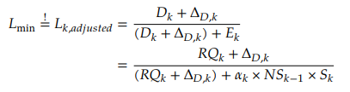
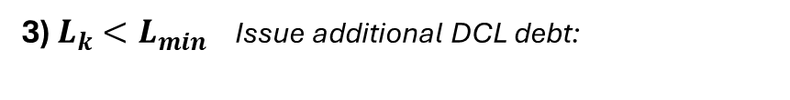
Dynamic Control of Leverage (DCL)
Dynamic control of leverage:
1) $L_{min}<L_{k}<L_{c}$ No adjustments needed.
Variables:
$$D_{k}$$ | Total debt
$$E_{k}$$ | Total equity
$${RQ}_{k}$$ | Residual value of DCL
$$α_{k}$$ | Ratio of DCL to total debt (${RQ}_{k}/D_{k}$)
$${NS}_{k−1}$$ | Total shares outstanding
$$S_{k}$$ | Stock price
$$P_{N_{n}}\left(T_{i}\right)$$ | DCL payment
2) $L_{k}>L_{c}$ Convert DCL payment into equity:
3) $L_{k}<L_{min}$ Issue additional DCL debt:
Notes:
The payment that would be due at time k
°
Set conversion price S_p

Slide 7
Research questions
How effective is the Dynamic Control of Leverage (DCL) framework in stabilizing banks during periods of financial distress compared to traditional CoCo bonds?
To what extent can the implementation of DCL-based CoCo bonds mitigate financial distress and influence outcomes across different types of banking crises?
What are the key parameters influencing the performance of DCL CoCo bonds,and how can they be optimized?

Slide 8
Case studies
Credit Suisse - Severe crisis and collapse
Deutsche Bank - Moderate stress
Lehman Brothers - Rapid systemic collapse
Notes:
Deusche bank: stress 2016-2018

Slide 9
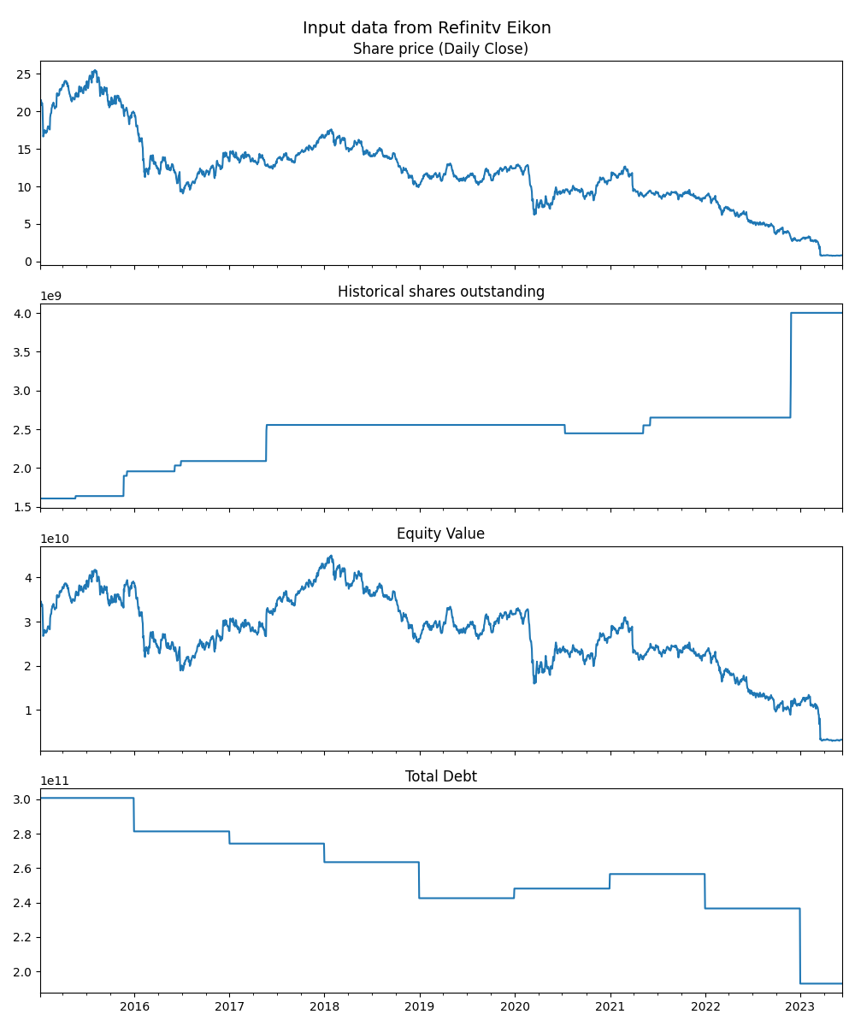
Methodology
Simulating DCL bonds for case studies:
Gather real-world data for:
Stock prices
Shares outstanding
Total debt
AT1 debt
Simulate leverage with and without Dynamic Control of Leverage (DCL)
Interpret the results
Leverage adjustments
Shareholder dilutions (additional share issuances)
Additinal DCL issuances
Compare DCL and non-DCL scenarios
Notes:
Limitations:
Doesn’t model shareholder reactions.

Slide 10
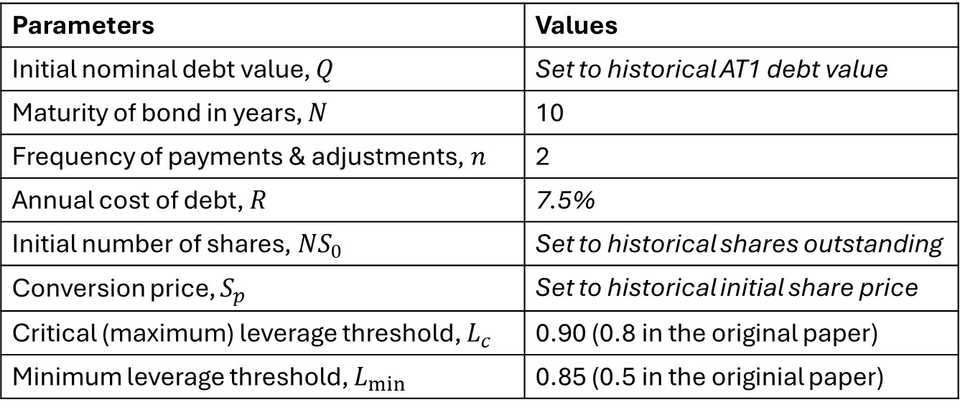
Parameters for DCL modelling
Parameters | Values
Initial nominal debt value, $Q$ | Set to historical AT1 debt value
Maturity of bond in years, $N$ | 10
Frequency of payments & adjustments, $n$ | 2
Annual cost of debt, $R$ | 7.5%
Initial number of shares, $NS_{0}$ | Set to historical shares outstanding
Conversion price, $S_{p}$ | Set to historical initial share price
Critical (maximum) leverage threshold, $L_{c}$ | 0.90 (0.8 in the original paper)
Minimum leverage threshold, $L_{min}⁡$ | 0.85 (0.5 in the originial paper)
Notes:
Baseline parameters used to simulate DCL:
R average for 2016
Max leverage (0.8 -> 0.90)
Min leverage (0.5 -> 0.85)
Biannual payments and adjustments
Conversion price set to the initial share price
Initial total equity: $CHF 34 bn$
Maximum leverage ($L_{c}$) set at 90%
Minimum leverage ($L_{min}$) at 85%

Slide 11
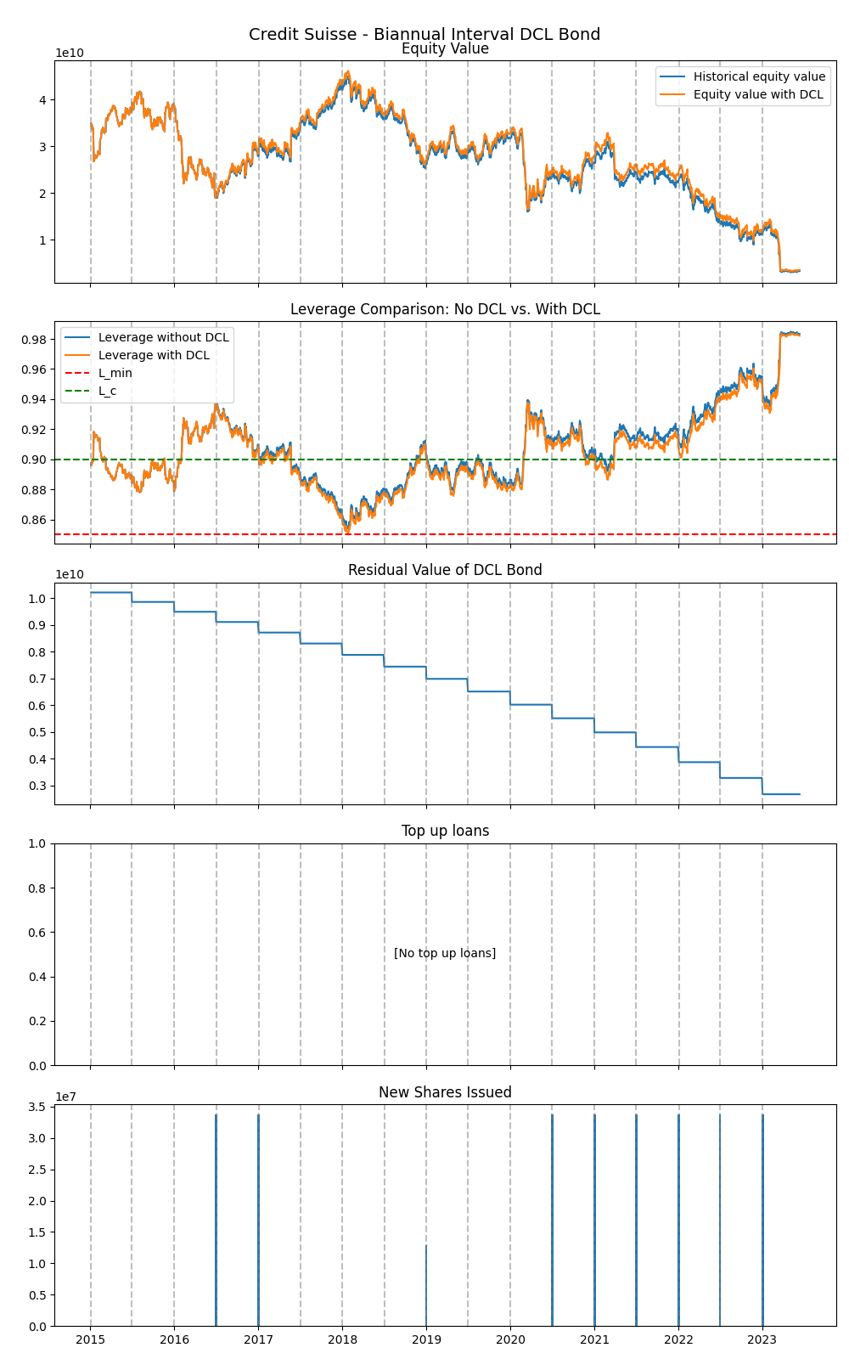
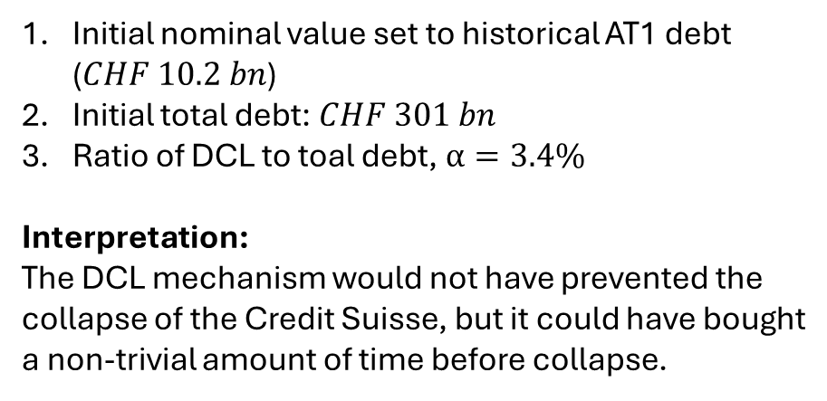
Results - Credit Suisse
Initial nominal value set to historical AT1 debt ($CHF 10.2 bn$)
Initial total debt: $CHF 301 bn$
Ratio of DCL to toal debt, $α=3.4\%$
Interpretation:
The DCL mechanism would not have prevented the collapse of the Credit Suisse, but it could have bought a non-trivial amount of time before collapse.
Notes:
2008 GFC: In response to the 2008 crisis, contingent convertible (CoCo) are introduced as a mechanism to strengthen bank stability by automatically converting debt into equity during financial distress.
March 19, 2023: The Swiss Financial Market Supervisory Authority (FINMA) announces the complete write-down of Credit Suisse's Additional Tier 1 (AT1) bonds, amounting to approximately CHF 16 billion.
Going forward: Dynamic Control of Leverage (DCL) introduced to prevent sudden drawdowns by only drawing down interest payments during times of high leverage, therefore gradually adjusting the balance sheet.
My task is to analyse DCLs in real world scenarios.

Slide 12
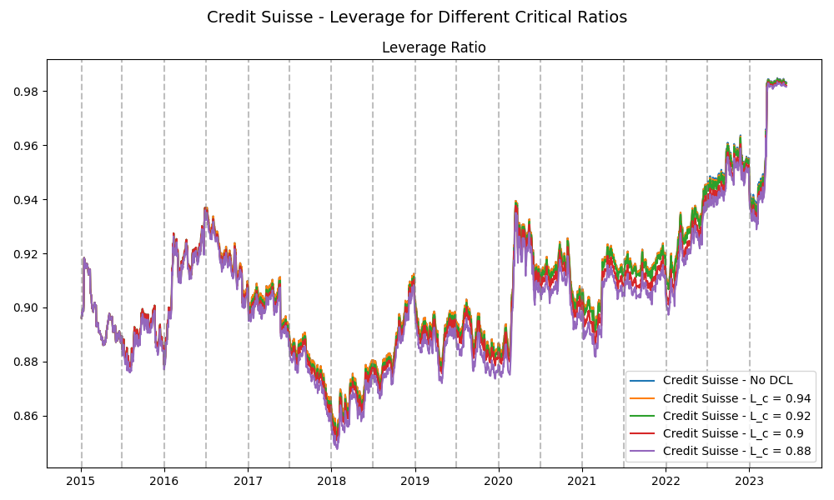
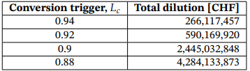

Slide 13
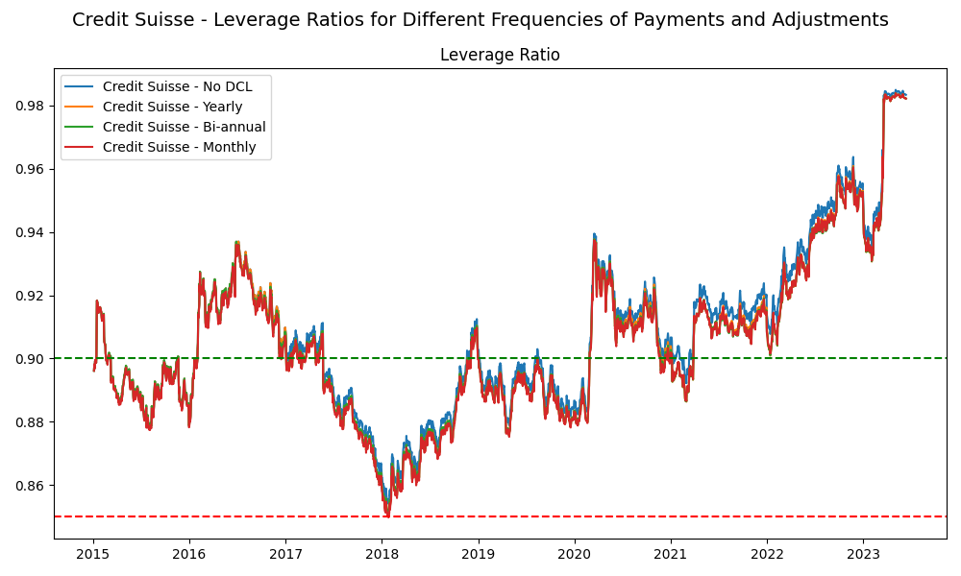


Slide 14
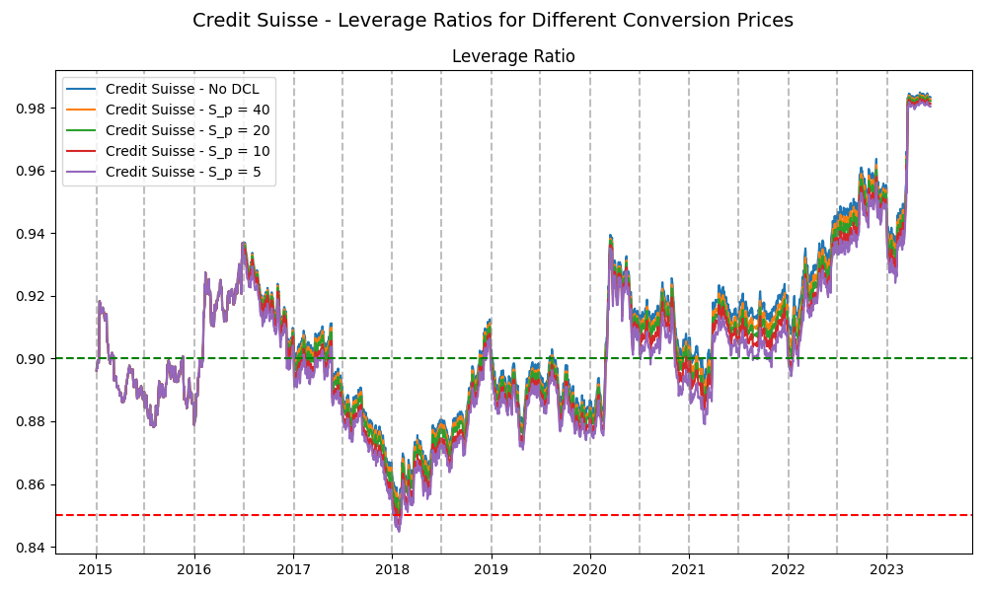
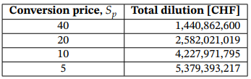
Notes:
If the price is high you get fewer shares
If the price is low you get more shares

Slide 15
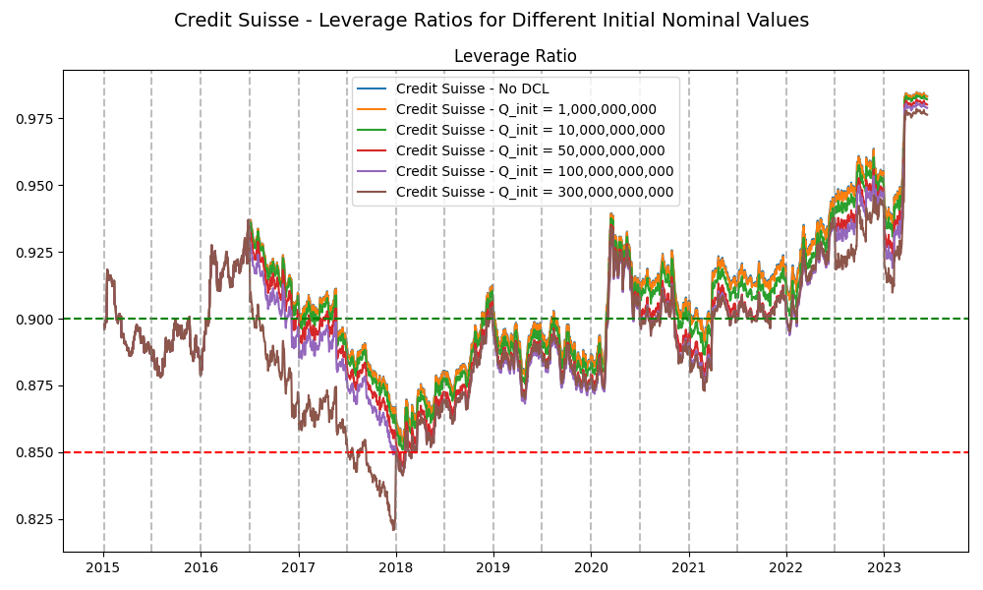
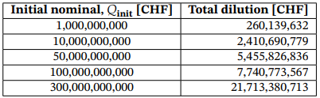

Slide 16
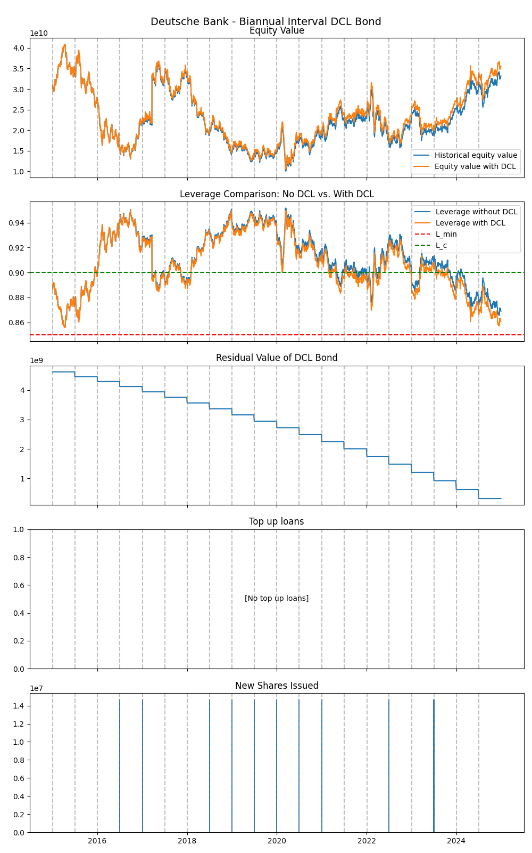
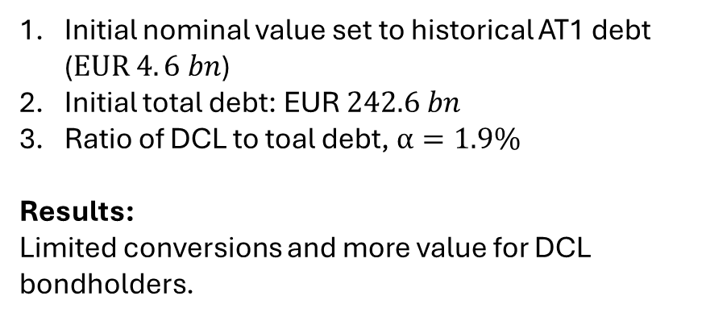
Deutsche Bank - Moderate stress
Initial nominal value set to historical AT1 debt ($EUR 4. 6 bn$)
Initial total debt: EUR$242.6 bn$
Ratio of DCL to toal debt, $α=1.9\%$
Results:
Limited conversions and more value for DCL bondholders.
Notes:
# Total AT1 debt for Deutsche Bank in 31 December 2024

Slide 17
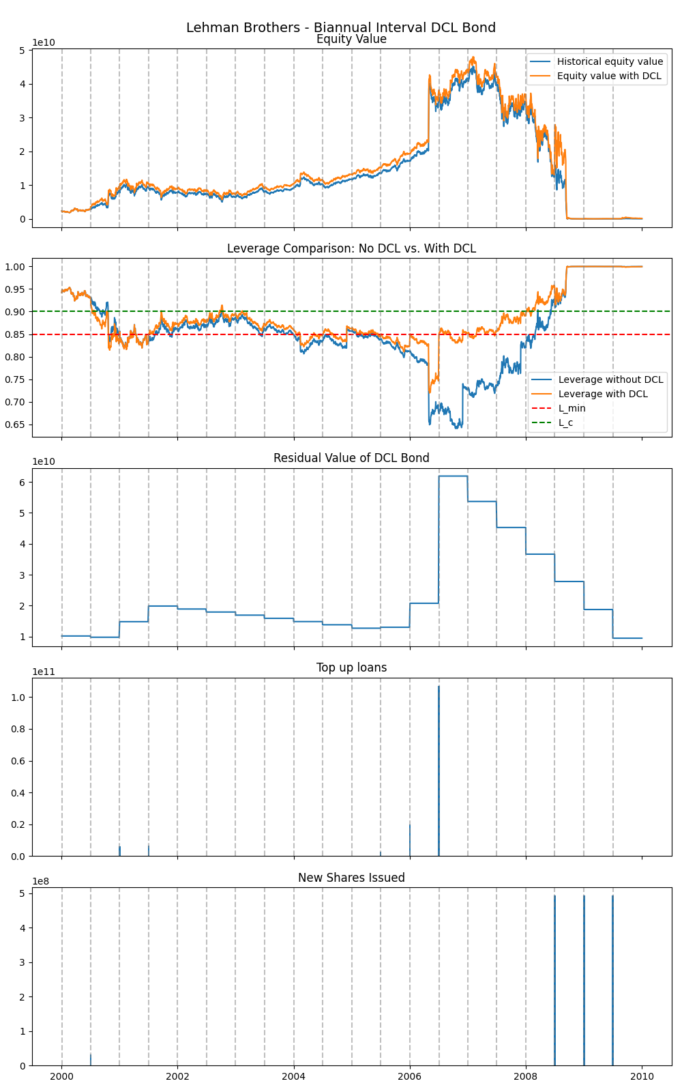
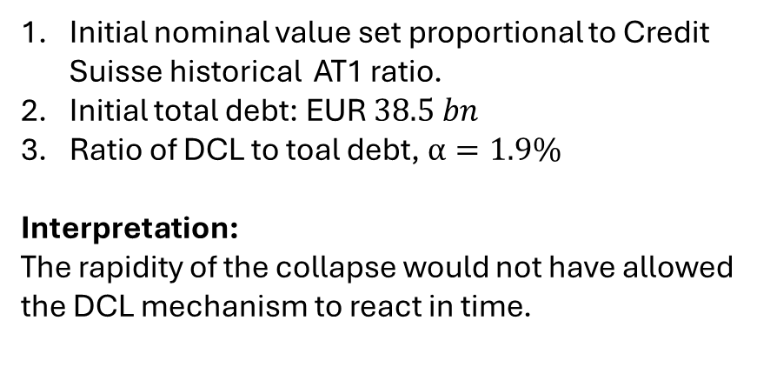
Lehman Brothers – Rapid systemic collapse
Initial nominal value set proportional to Credit Suisse historical AT1 ratio.
Initial total debt: EUR$38.5 bn$
Ratio of DCL to toal debt, $α=1.9\%$
Interpretation:
The rapidity of the collapse would not have allowed the DCL mechanism to react in time.

Slide 18
Case Studies - Summary
Deutsche Bank - Moderate stress
No collapse scenario - greater value for bondholders
Credit Suisse - Severe crisis and collapse
DCL effectively delays the collapse
Lehman Brothers - Rapid systemic collapse
DCL has a limited effect due to the speed of collapse

Slide 19
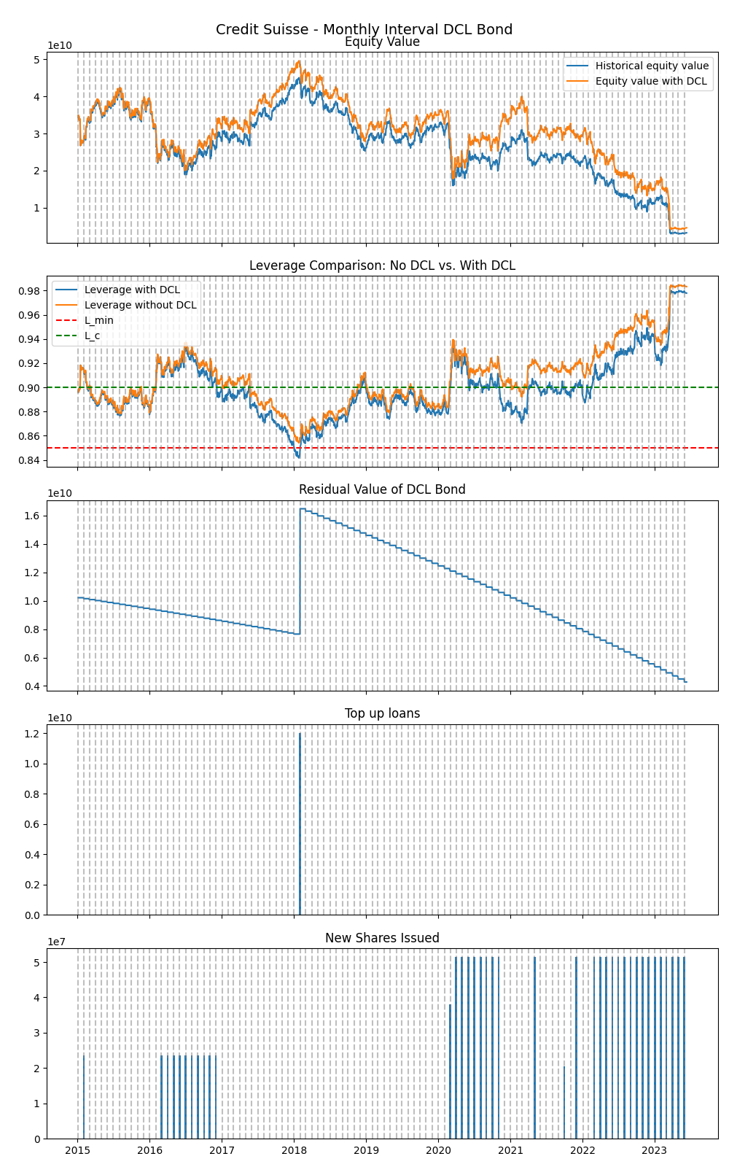
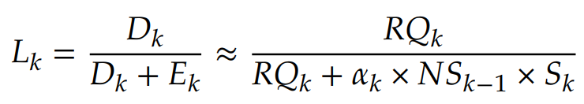
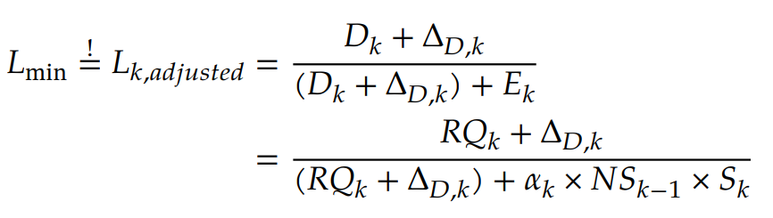
Results of Higher Leverage Thresholds
Leverage adjustment asymmetry
Minimum leverage adjustments require larger top-up loan issuances
Notes:
How that manifests
Around 12 Billion CHF

Slide 20
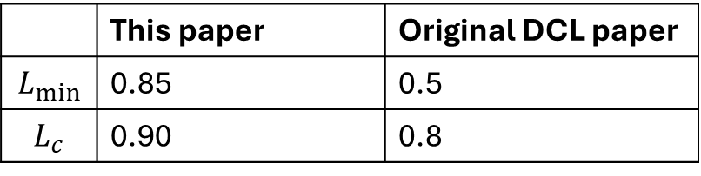
Discussion - Results of Higher Leverage Thresholds
 | This paper | Original DCL paper
$$L_{min}$$ | 0.85 | 0.5
$$L_{c}$$ | 0.90 | 0.8

Slide 21
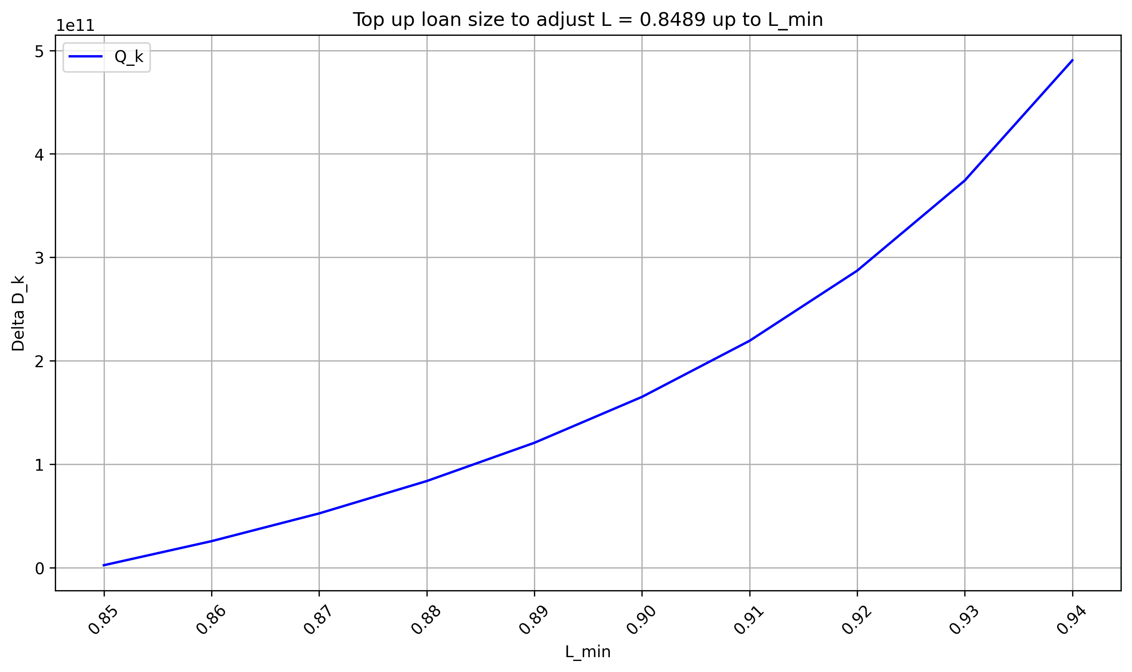
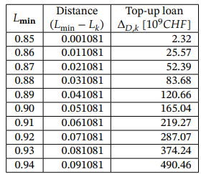
Results of Higher Leverage Thresholds

Slide 22
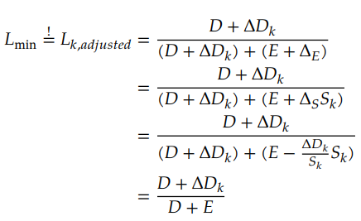


Solving leverage adjustment asymmetry
Using the top-up loan, the company could do share buybacks (or pay a cash dividend) to reduce the equity value at the same time as it increases the debt
Leverage adjustment with share buybacks:
Top-up loan size with share buybacks:
Top-up loan size without share buybacks:

Slide 23
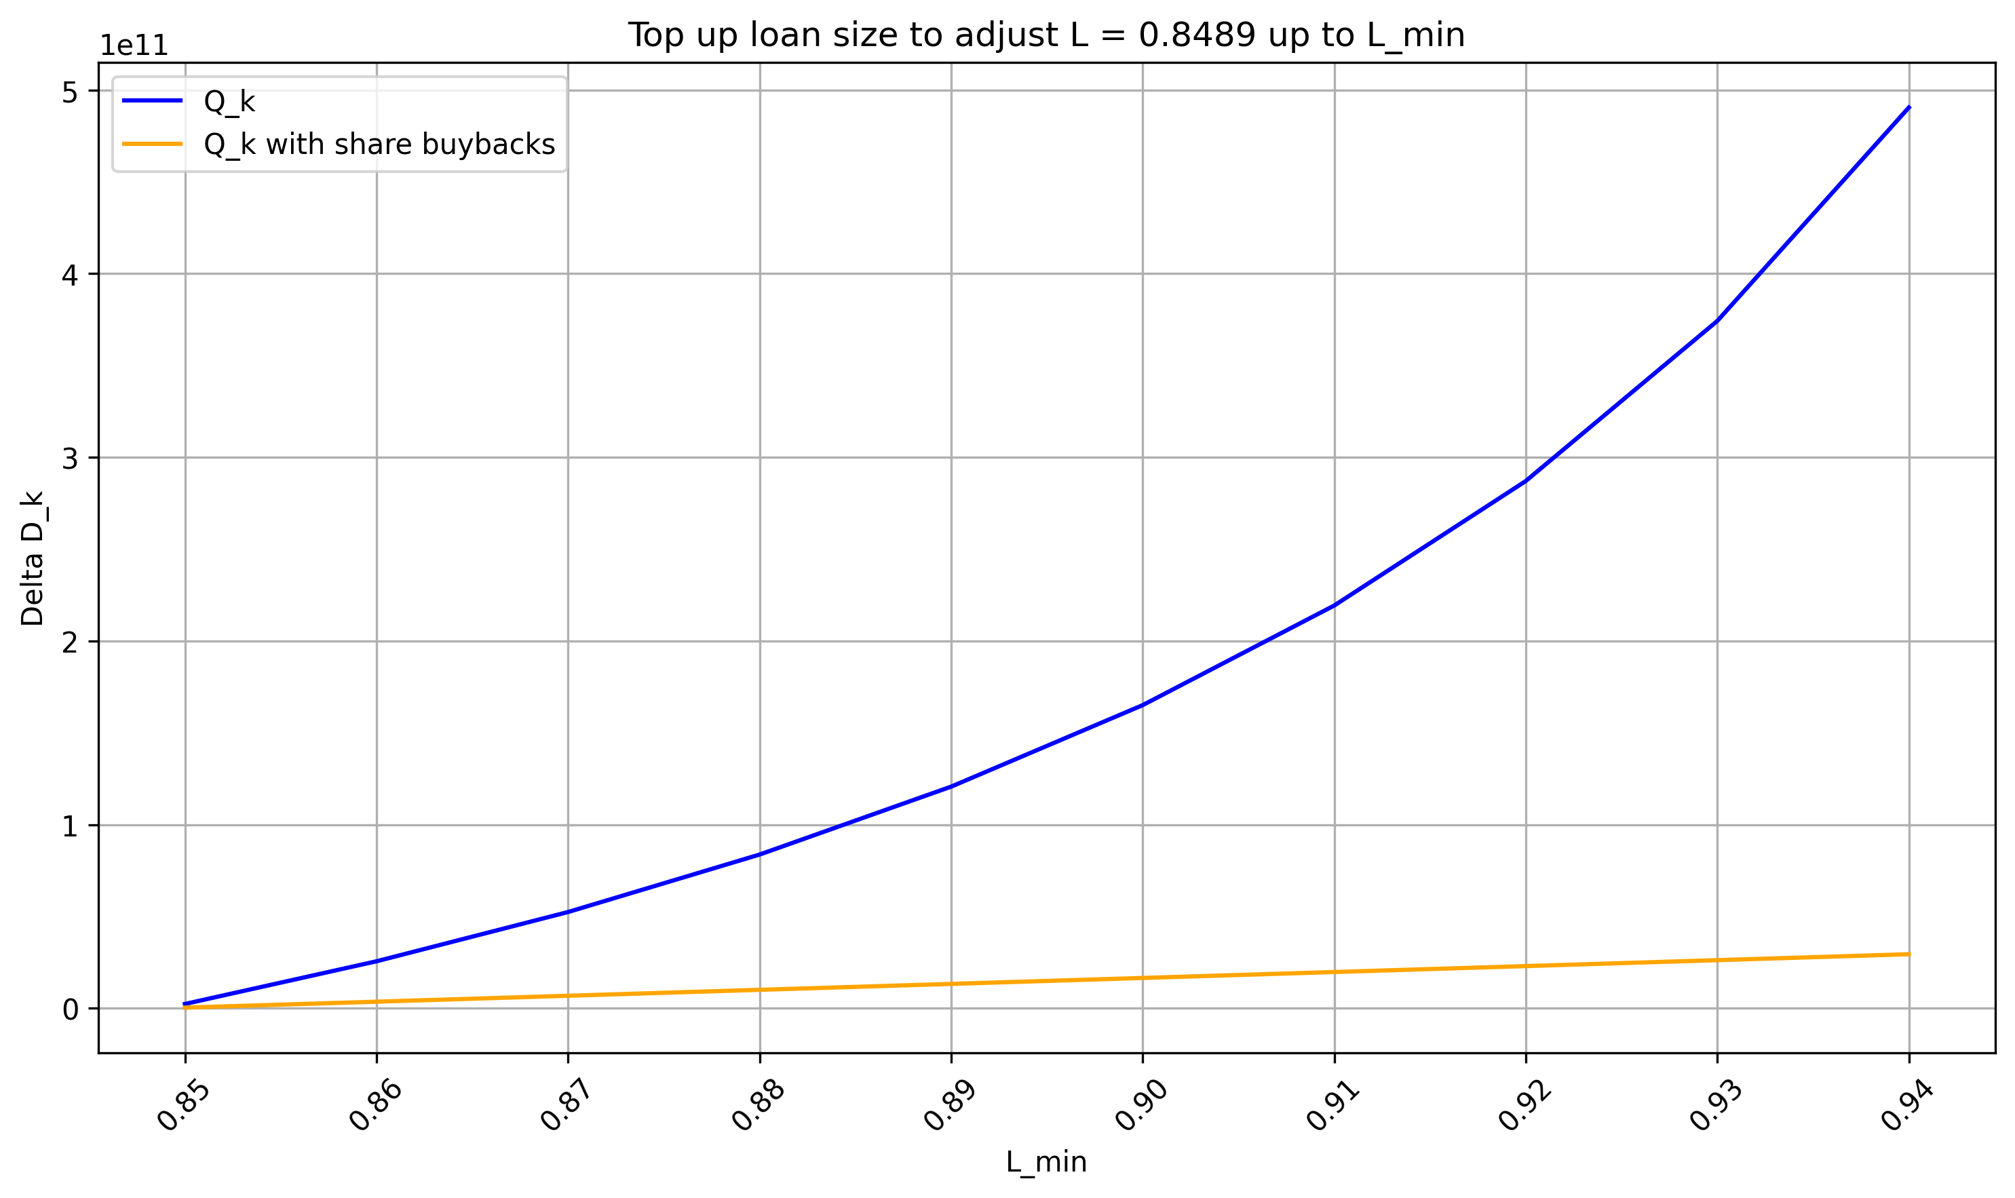
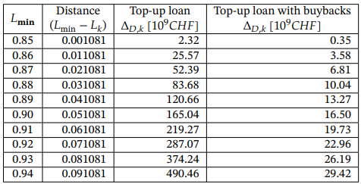
Solving leverage adjustment asymmetry

Slide 24
Discussion – Time gained under DCL
Rather than preventing banks from collapsing, the additional time gained before collapse should not be underestimated.
The parameters of DCL bonds could even be determined with the goal of achieving a certain amount of time gained.
Notes:
Time can be used for additonal actions like merger deals or fixing the balance sheets of the bank.

Slide 25



Discussion – Time as a design objective
Time gained before collapse
Time gained is inherently stochastic
Can use Monte Carlo simulations to estimate it:

Slide 26
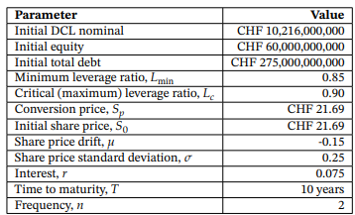
Monte Carlo framework for estimating time gained
Monte Carlo simulation parameters
Notes:
Explain what monte carlo is:
Creates different stock prices (paths) that we can run a DCL simulation on.

Slide 27
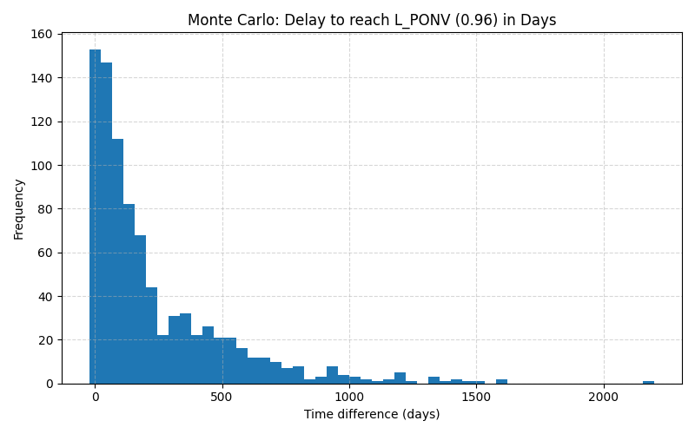
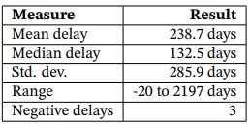
Monte Carlo Results (2000 runs)

Slide 28
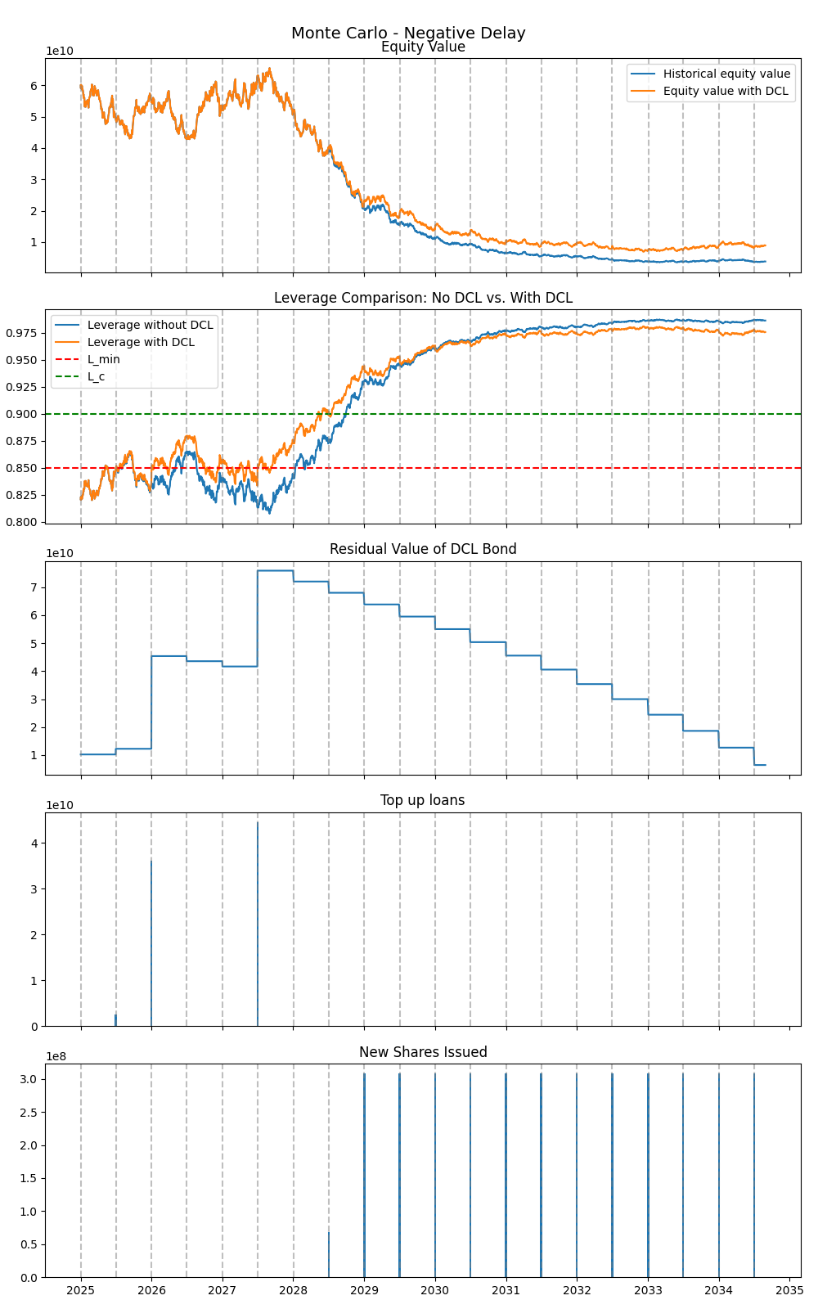
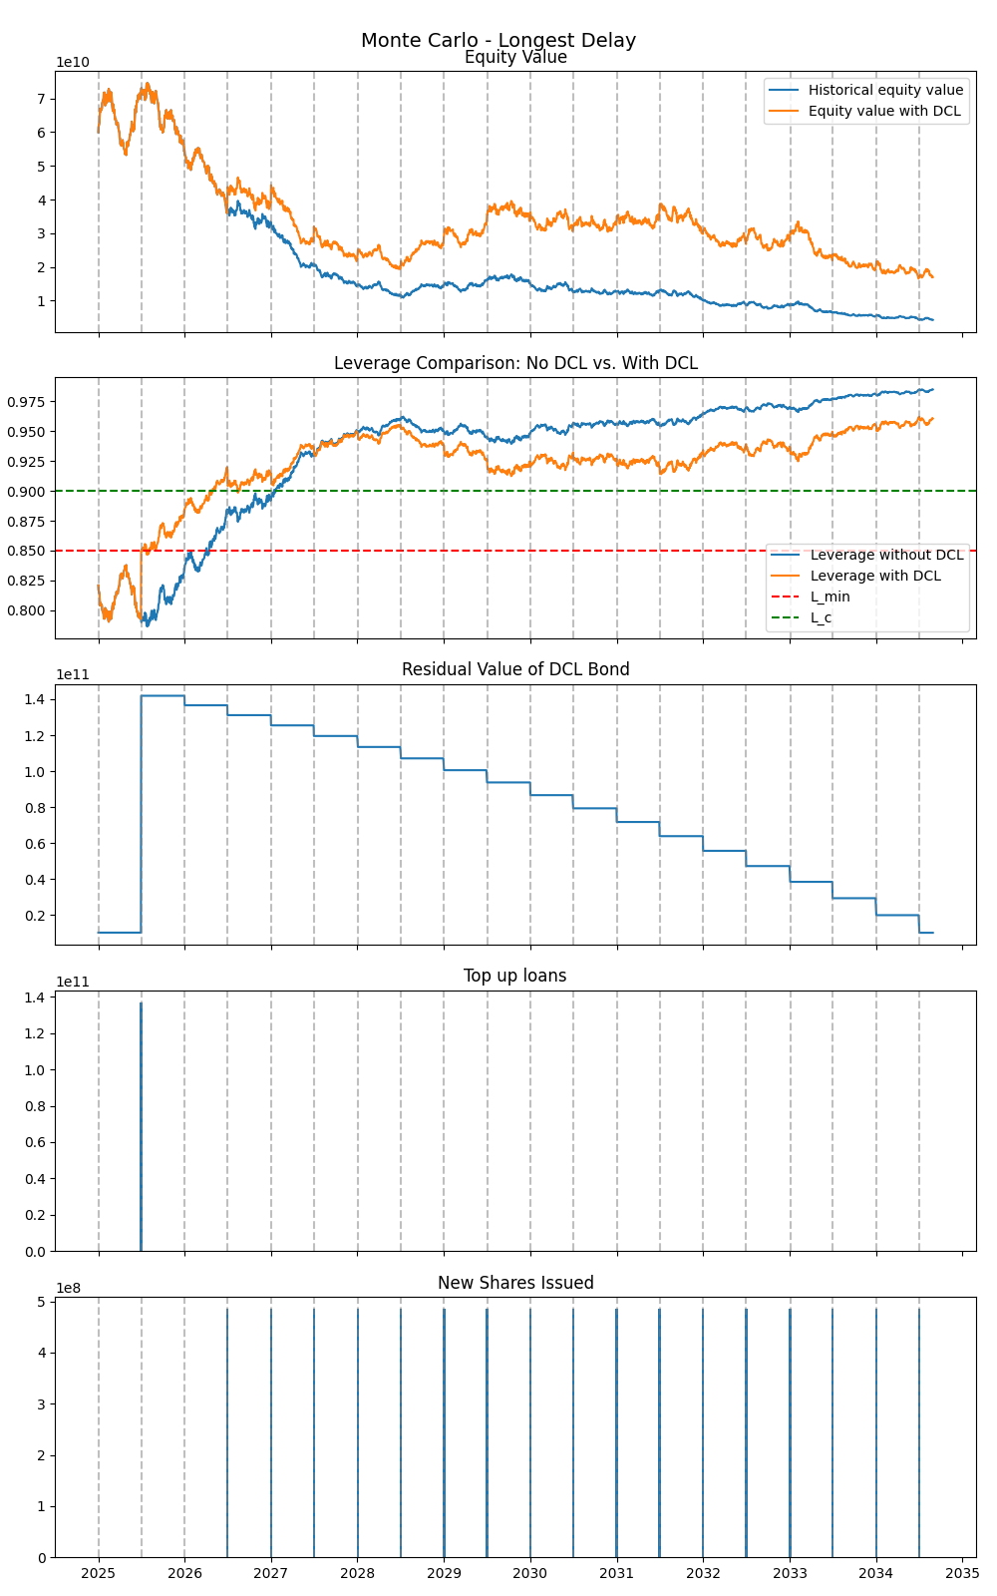

Slide 29
Summary and Conclusions
How effective is the Dynamic Control of Leverage (DCL) framework in stabilizing banks during periods of financial distress compared to traditional CoCo bonds?
To what extent can the implementation of DCL-based CoCo bonds mitigate financial distress and influence outcomes across different types of banking crises?
What are the key parameters influencing the performance of DCL CoCo bonds,and how can they be optimized?
Notes:
Future work (
Simulations using DCL on all the debt,
Investor perception around DCL,
Additional analysis on the pricing of DCLs
More complex monte carlo simulations
)

Slide 30
Thanks!

Slide 31
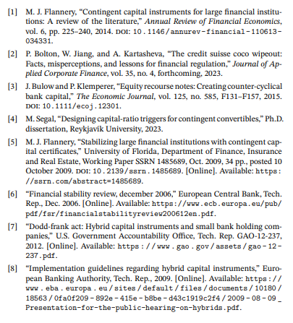
Bibliography

Slide 32
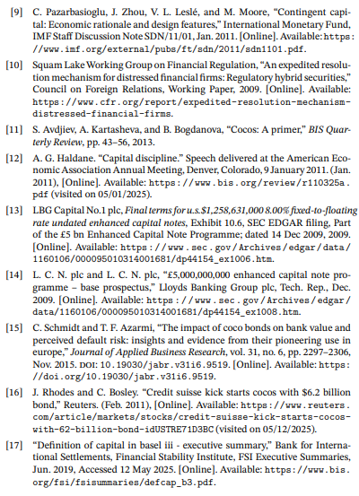
Bibliography

Slide 33
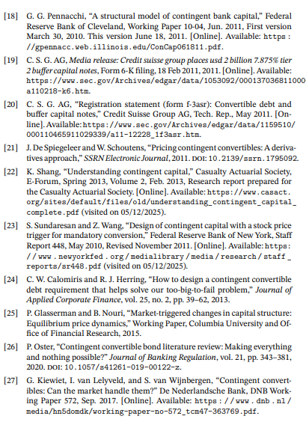
Bibliography

Slide 34
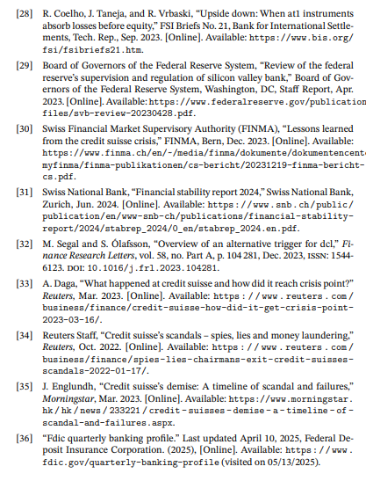
Bibliography

Slide 35
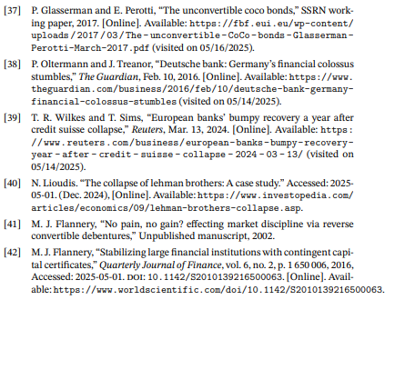
Bibliography

